Slide 1

Continuation Pay Under BRS
Version 2.0 October 2023

Slide 2




Agenda
Continuation Pay Basics
Application Process
Financial Implications
Resources

Slide 3

Continuation Pay Basics
WHAT is Continuation Pay?
WHO is eligible to receive it?
WHEN can you receive it?
WHY is it being offered?
HOW is it calculated and disbursed?

Slide 4
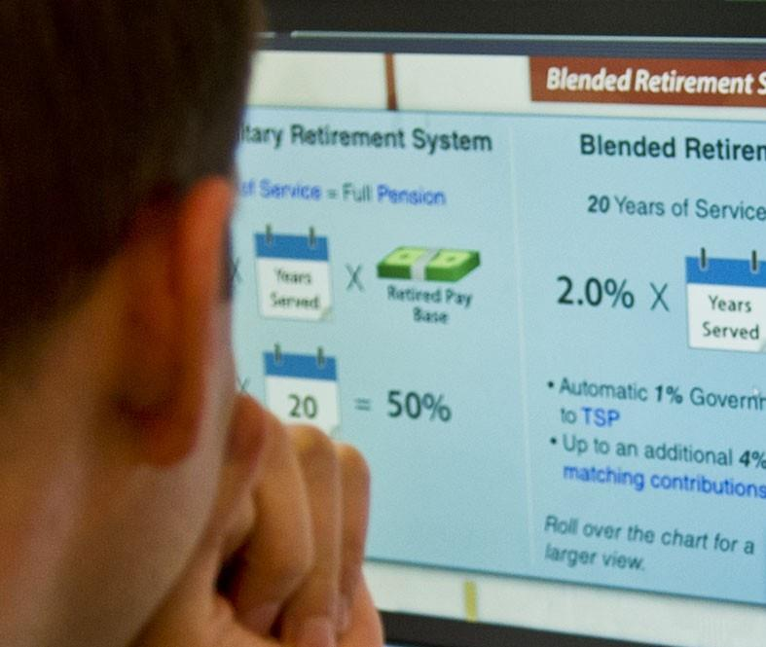




What is Continuation Pay?
Part of the Blended Retirement System (BRS)
One-time, mid-career bonus set by the Army
In addition to other incentives and bonuses
A retention tool in exchange for additional service obligation
Notes:
Image Source: https://media.defense.gov/2017/Feb/01/2001693473/825/780/0/170130-D-BN624-001.JPG

Slide 5




Who Is Eligible and
When Can It Be Received?
Active and Reserve Component Soldiers
BRS participant
Payable between completion of
8 YOS but before 12 YOS; exact time, multiplier and additional service obligation set by the Army each year.
Election is irrevocable
5
Notes:
Image Source: https://www.army.mil/article/219838/soldiers_civilians_benefit_from_us_army_financial_management_commands_e_commerce_training

Slide 6



How Is It Calculated?
CURRENT MULTIPLIERS:
PAY-RATE MULTIPLIERS MAY BE BASED ON:
Service-specific retention needs
Specialty & hard-to-fill positions
Similar to career incentives and
re-enlistment bonuses
CURRENT MULTIPLIERS
Service-specific retention needs
Specialty & hard-to-fill positions
Similar to career incentives and
re-enlistment bonuses
Active Duty
Including Active Guard Reserve (AGR)
National Guard
or Reserve
(In a Drilling Status)
FROM
2.5 to 13
TIMES MONTHLY
BASIC PAY
FROM
0.5 to 6
TIMES MONTHLY
BASIC PAY

Slide 7
Calculating Continuation Pay
Monthly Basic Pay
X
Multiplier
=
Gross Pay
‒
Tax Withholding
=
Net Continuation Pay

Slide 8
Calculating Continuation Pay
Example: CPT with 10 years from PEBD; Calendar Year 2023 rates
Reserve Component
Monthly Basic Pay × (.5 to 6) = Gross Pay – Tax Withholding = Net CP
$7,340 | × | 4 | = | $29,360 | – | 22%* = $6,459 ($29,360 × .22) | = | $22,901
Active Component (including AGR)
Monthly Basic Pay × (2.5 to 13) = Gross Pay – Tax Withholding = Net CP
$7,340 | × | 2.5 | = | $18,350 | – | 22%* = $4,037 ($18,350 × .22) | = | $14,313
* Applicable state and federal taxes are subject to individual tax filing status; subject to change each year. 22% used as baseline for federal tax withholding.

Slide 9

How Is It Disbursed?
You can choose to receive a one-time payment or spread your payments to potentially save on taxes
One Installment Paid 5-7 days after certification and submission to the servicing finance office from the unit S-1..
Two Equal Installments Paid 5-7 days after certification and submission to the servicing finance office from the unit S-1; the next installment is paid the following year.
Three Equal Installments Paid 5-7 days after certification and submission to the servicing finance office from the unit S-1; the next installments paid in two equal annual installments.
Four Equal Installments Paid 5-7 days after certification and submission to the servicing finance office from the unit S-1; the remainder in three equal annual installments.
CHOOSING AN INSTALLMENT PLAN
Remember, Continuation Pay
is subject to tax withholding!
Your payment choice may affect taxes owed.
Review the IRS Tax Withholding Estimator.

Slide 10
Requesting Continuation Pay
Complete the Request for Continuation Pay Form

Slide 11




Financial Implications
What Can Be Done with Continuation Pay
Tax Considerations
Considerations for Investing Continuation Pay into the TSP
Failure to Meet Service Obligations

Slide 12
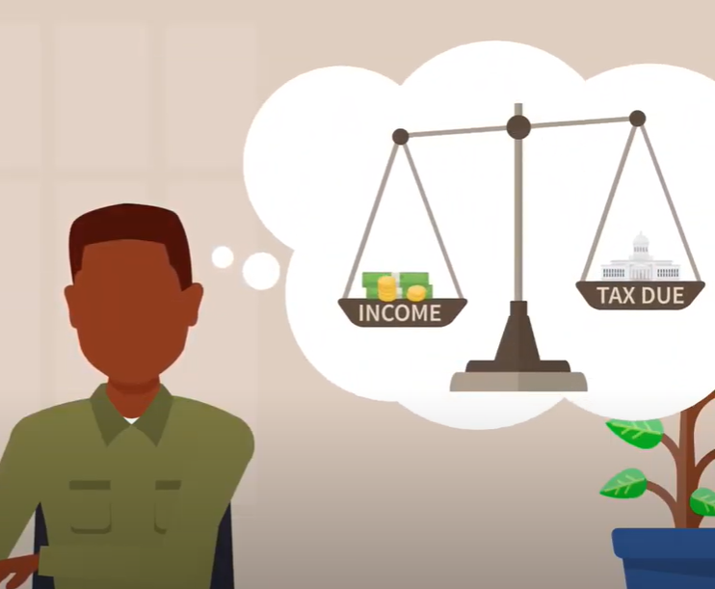
What Are the Tax Considerations?
Continuation Pay is EARNED income and is taxed accordingly
More income may push you into a higher tax bracket
  Consider multiple
  installments
Notes:
Image Source: https://www.youtube.com/watch?v=0ejviqr3Qdo&t=29s&ab_channel=DoDFINRED

Slide 13
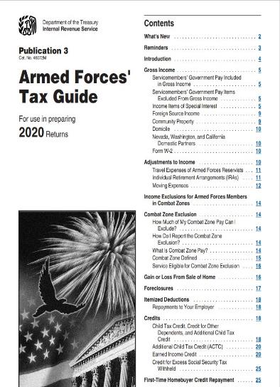

Tax Resources
Consider reviewing:
  IRS Publication 3: Armed
  Forces’ Tax Guide
  Combat Zone Tax Exclusion

Slide 14
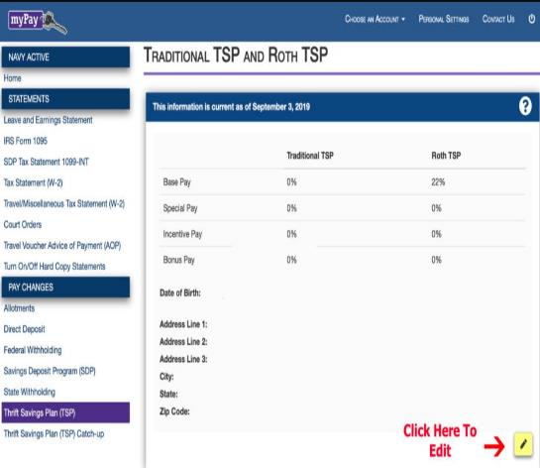
What Are the Conditions and Limitations of
Investing Continuation Pay into the TSP?
Considered bonus pay
Invest into TSP through myPay.dfas.mil
  No matching funds
  Elect bonus pay
  Elect Traditional TSP,
  Roth TSP, or a
  combination of both

Slide 15


What Are the Conditions and Limitations of Investing
Continuation Pay into the TSP?
IRS Annual limits apply
  Max out early lose future
  Service Matching Contributions
  until Jan.1st of the following
  calendar year
Combat Zone Tax Exclusion (CTZE)
Notes:
Image Source: https://pixabay.com/photos/calculator-calculation-insurance-1044172/

Slide 16








What Can You Do with
Your Continuation Pay?
Take a thoughtful approach
    Pay down debt
    Save for emergencies
    Invest for the future
    Make a major purchase
    Gift it
Beware of misleading
consumer practices
  Sources of Help for
  Military Consumers
  Protect yourself against
  identity theft, scams, and fraud
Notes:
Image Source: DVIDS

Slide 17


What if You Don’t Meet
Your Service Obligations?
Must be in a pay status for the entire service obligation
Must repay all or part of Continuation Pay
Installment options can help alleviate the financial burden
Notes:
Image Source: https://pixabay.com/photos/dollars-banknotes-money-cash-bills-426023/

Slide 18
Summary and Resources
18

Slide 19




Summary
Congratulations on reaching
this important milestone!
Let’s recap what you learned as you
approach eligibility for Continuation Pay:
Continuation Pay Basics
Application Process
Financial Implications
Notes:
Image Source: DVIDS

Slide 20



Resources and Conclusion

Slide 21

Thank You!

